Slide 1
Using “Junior Data Journalism” in Regional and Daily news
With Clara Pasieka
Twitter: @PasiekaOnPol

Slide 2
Junior Data Journalism is great because…
If you are competing in the daily regional news market, chances are using data will give you stories your competitors and colleagues don’t have
Everyone thinks they don’t have time, but actually, the opposite is true with junior data journalism. These data stories can give you new ideas that save you time in daily news pitching, which can be pretty exhausting.

Slide 3
But what does it Look like?
This is not an official term. I made it up. Do not use it in newsrooms assuming it it a thing.
It is fast.
It uses data you may need to ask for, but data that is readily accessible to your sources that you should be given within a few hours if you can’t find it yourself

Slide 4
some Tips & examples

Slide 5
Tip
If the government doesn’t give you what you want or gives you something incredibly vague and says they can’t give out employee numbers or details, go to the local union rep.
Note: The national rep in Ottawa or Toronto will mostly likely not be able to give you what you need data wise, but may serve other purposes or give you nice umbrella quotes.

Slide 6
Here’s what that looked like for me…
I had a hunch Atlantic Canadian Correctional institutions were experiencing a correctional officer shortage and it would be worse in the pandemic.
I was right.
I had a union rep pull me every leave and the numbers to determine how bad this shortage was and had them explain their concerns in this story:

Slide 7
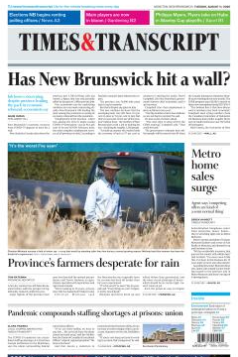
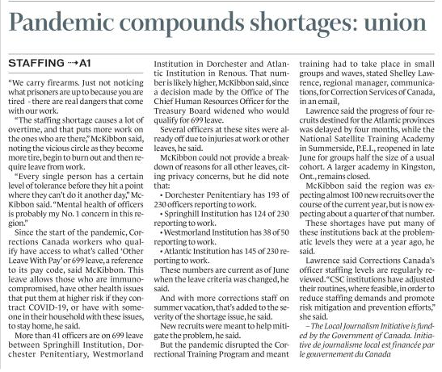
.
The COVID-19 pandemic has exacerbated staffing shortages at Corrections Canada institutions in the Maritimes, says the union representing federal correctional officers.
“If we are short-staffed, we have to stay late.... We can’t just leave the doors closed and walk away,” said Bev McKibbon, the Union of Canadian Correctional Officers' Atlantic regional president. "We have to be there."
And that means a reduction in turnaround times between shifts, and an increase in worker fatigue which can decrease sharpness on the job, McKibbon said.
“If you're not sharp and you're working in a prison, that's dangerous,” he said

Slide 8
Tips for Turning anecdotal leaning stories Daily News Thrives off of into data stories
Possible situations:
A: Your editor thinks a bunch of ppl are probably X Because at least one person they know or have seen online is X Which makes them think probably lots of people are X And now wants a soft story about X.
Solution A: Use polls and market research to support an assignment for an anecdotal story
B: You have no pitches and your brain feels dead
Solution: Scan the polls and pitch the poll based off of regional outlier responses and find anecdotes second to support the data with a human face

Slide 9
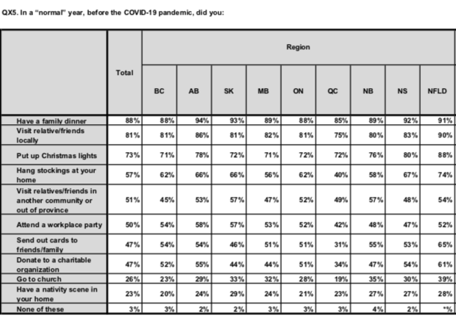
Here’s how this often looks for me…
Key tips: Always always search for or ask for the full charts with regional response breakdowns. They have them.
Always look for outliers to have a strong lede. “Atlantic Canadians less able to identify covid symptoms than those in any other region” is much better than “Manitobans most average respondents to X”
Always find a human face, ideally two or three, because remember you are doing this because you want to go beyond an anecdote

Slide 10
A few Examples…
There are so many examples from 'are people in the province attending church in person this year with COVID being what it is’, to ‘are more people thinking of getting a camper trailer’, to ‘what are people most looking forward to when the pandemic is over?’
The human faces makes it a full story, because 99 per cent of the time you can’t run a picture of a number on A1.

Slide 11
Turning press releases into better stories
Tips: Always read the whole report
Appendixes are your friend
When you share data that others aren’t writing about, go meta and talk to your sources about how this data effects them
See if you can split a story into two when you get a good report, know that your first overview story your competition may have also, but you are tying up the game tonight to win tomorrow.
Know that Indigenous stories may take more time, but they are worth doing

Slide 12
Here’s that Story…
https://www.thestar.com/news/canada/2020/12/20/indigenous-child-poverty-rates-more-than-double-provincial-average-report.html

Slide 13
Getting through Dead News Periods
Use data. Only real people can ignore you. Data will be there for you while everyone else is on Christmas vacation, but for goodness sakes, do data, but make it fun…for people besides you.

Slide 14
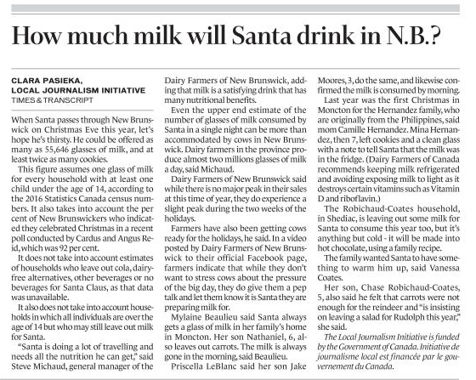
Here’s what that looked like for me…
Have you ever read an estimate of the number of glasses of milk possibly consumed by Santa Claus while travelling over your province?
Neither had readers…until now.

Slide 15
In summary
Probably nobody will tell you not to put data in your story. They might tell you to put less if it is crowding your humans.
If you are a nerd in daily news, see what junior data journalism might look like for you.
These are just what worked for me, go ahead and ignore them all, but find your own path that allows you to use data in meaningful ways for you.

